Slide 1
Docker / Rkt
Working with acbuild and dockerfiles
29/01/2020

Slide 2
On this document…
Some concepts!
What is acibuild?
How it works?
Getting started with acibuild
What is a dockerfile?
Conventions and sintaxis
Good practices
Getting started with dockerfile

Slide 3
Some concepts!

Slide 4
What is acbuild?
As we previously seen, rkt works with his own image format named ACI. ACI images are closely related with appc, that’s because appc defines several independent but composable aspects involved in running application containers, including an image format, runtime environment, and discovery mechanism for application containers. It creates images known as ACI. ACI’s full form is Application Container Image
acbuild is a simple unix utility for constructing ACI manifests and container filesystems. acbuild presents options for mapping ports, mounting filesystems, and specifying the base containers from which higher-level images are built

Slide 5



How it works?
Build an ACI Image is easy as define a text file and invoking acibuild from command line. It’s important remark that acbuild ONLY WORKS OVER GNU/Linux operating systems. So, we need to define image’s specification in a bash script

Slide 6
Getting started with acbuild

Slide 7
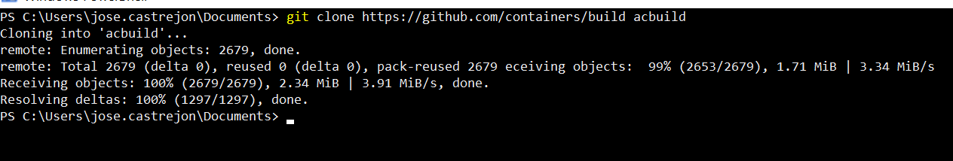
Trying out with Vagrant
First step is obtain and acbuild vagrant image, so we must perform a git clone command over his repo

Slide 8
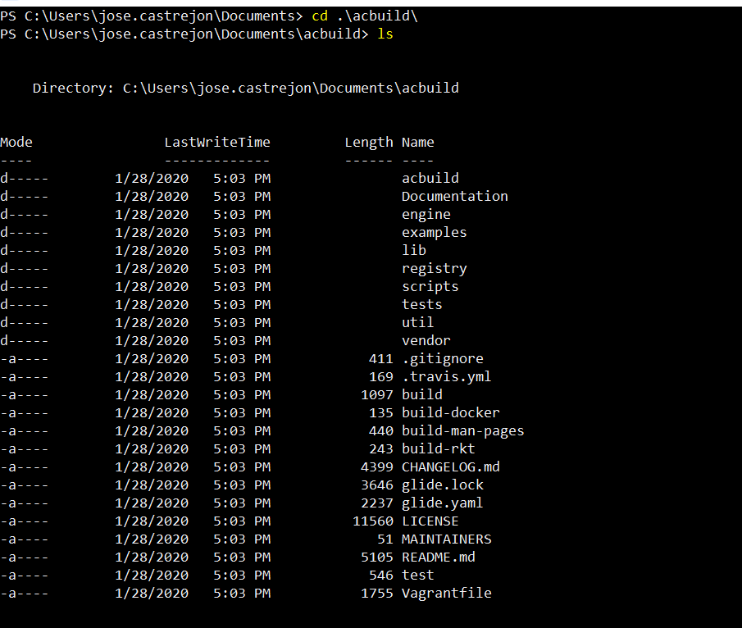
Trying out with Vagrant
Afterwards it’s time to perform an cd to the
Cloned folder in order to provision and run the
Vagrant machine.

Slide 9
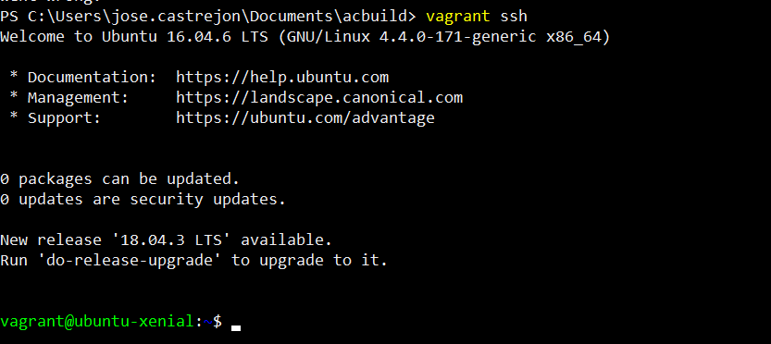
Trying out with Vagrant
So, by typing vagrant ssh our vagrant machine is provisioned, up and running! Fully operative!

Slide 10
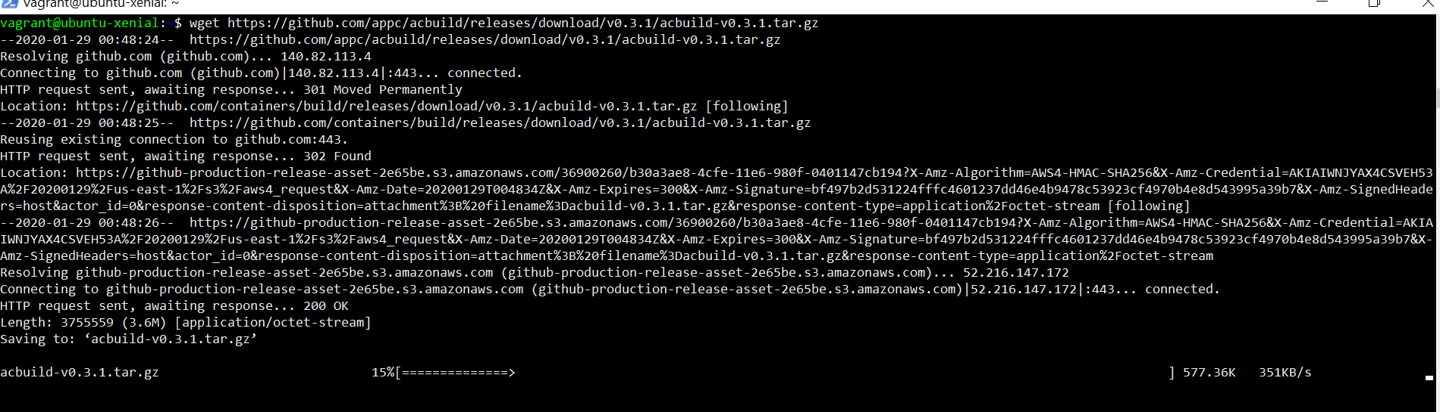
Trying out with Vagrant
Now, we gonna obtain the executable by performing a wget over the acbuild github repo

Slide 11
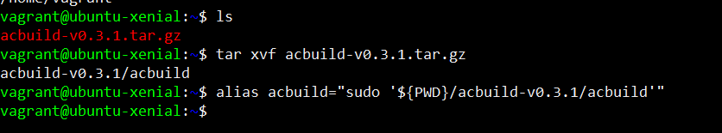
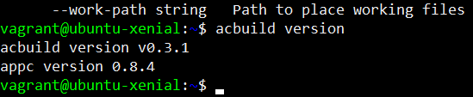
Trying out with Vagrant
When tar.gz file is downloaded we have to set an alias to the acbuild in order to include it on our PATH. You can verify that it’s correctly aliased by typing acbuild version, which will show you the exit you see below.

Slide 12


Trying out with Vagrant
Building an ACI image it’s possible by follow a basic sequence. It typically begins by giving acbuild the context, which means an entry point and a finish point using the begin and end directives as acbuild arguments. Between acbuild begin and acbuild end we’ll set all instructions in order to configure and write the ACI Image to disk. Let’s do that!

Slide 13
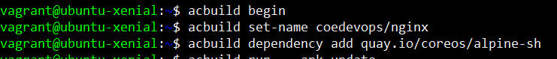
Trying out with Vagrant
First step is give the context to our new image, name it and stablish the base image in order to get a fully operative ACI file. We can achieve that by typing the begin, set-name and dependency add options with acbuild command

Slide 14
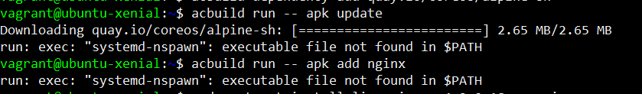
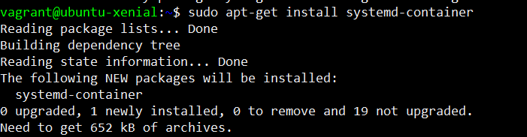
Trying out with Vagrant
In this case, we found an error while trying to specify two Alpine’s package manager operations into our ACI (apk is the command to invoke in order to make package operations). System show us that system-nspawn is not present in our system, so we gonna install it and retry the acbuild run instruction.

Slide 15
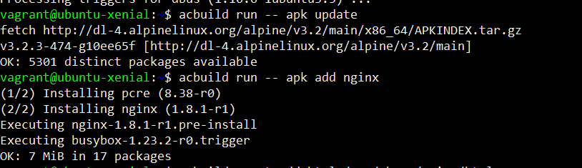
Trying out with Vagrant
Once we have systemd-nspawn and after retry to add the run – apk update directives in order to install nginx over our aci all the operations will be successfully performed.

Slide 16
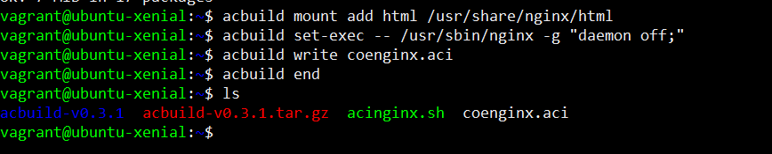
Trying out with Vagrant
The next step is mount the file system for nginx, making the nginx runnable by executing the bin file and finally WRITE THE ACI to the disk!

Slide 17
Run overview
In this case we are running a new pod from a custom ACI Image, it is not signed, that’s why we’re adding the
--insecure-options=image flag, it’s followed by the name of our custom image coenginx.aci. We also added a volume in order to serve the html file from that location and attached a network as host.

Slide 18
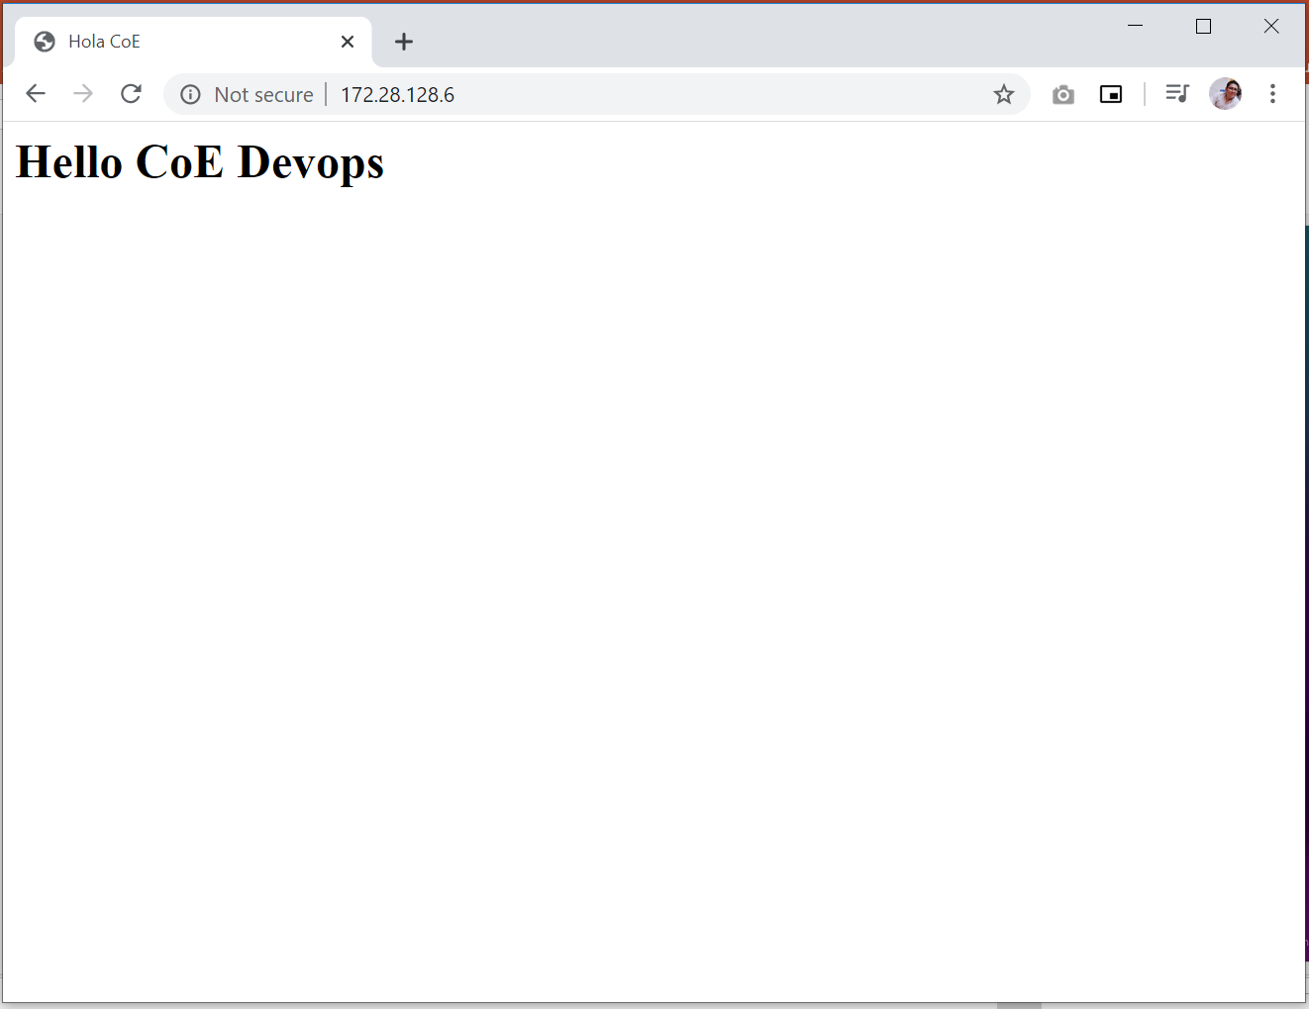
And voilà!

Slide 19
Now it’s Docker time!

Slide 20
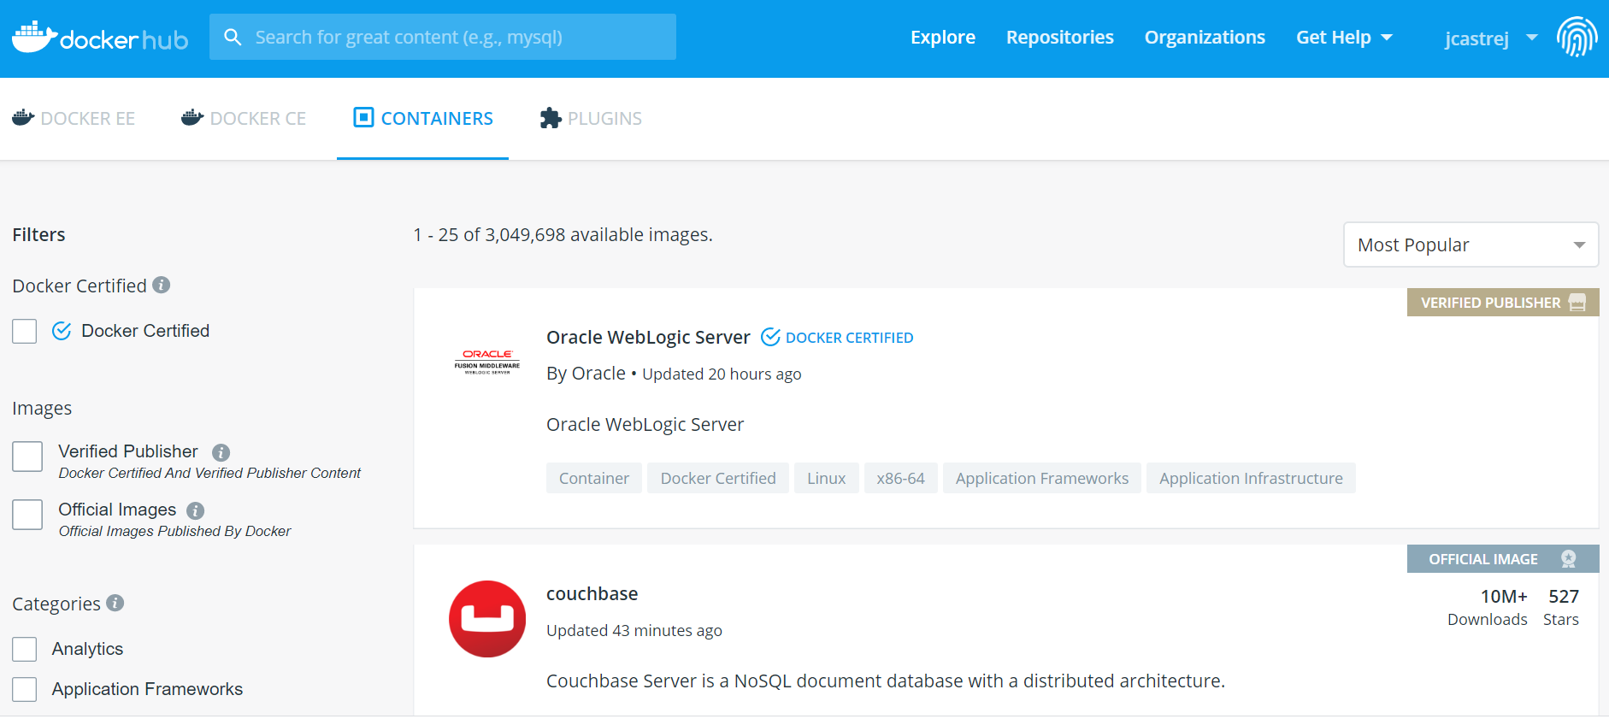
What’s a Dockerfile?
As we know, Docker provides a Docker Hub with a lot of images which will help us to create powerful containers, most of them are Docker Certified or published for members of the community. There are a lot of images intended to work with the most popular tools for developers, DBA’s, DevOps, etc.

Slide 21
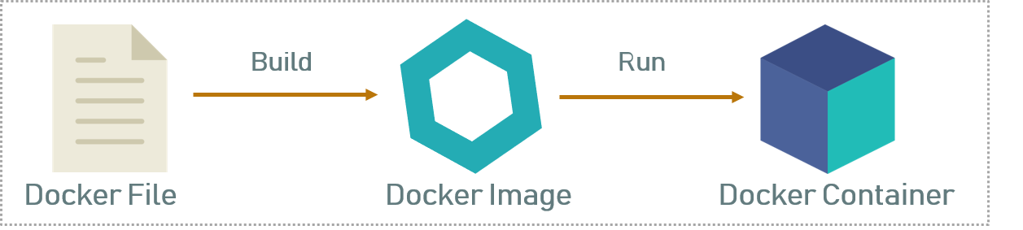
What’s a Dockerfile?
But, what if we need a custom Docker Image with personalized software which matches exactly with the requeriments of your project? We’ll, Docker offer us a solution: it allows to create a text file with the requeriments we need to run and gives us a tool which will help us to build that image and run containers based on that file. This solution is the Dockerfile.

Slide 22
Getting started with Dockerfiles!
Dockerfiles has a simple sintaxis and help us to build images automatically by reading instructions from them. The main steps to build a custom image are as follows:
Create a new folder which contains the dockerfile
Fill the dockerfile with our custom directives and instructions
Build the custom image by running the docker build command

Slide 23




Getting started with Dockerfiles!
Dockerfiles has a simple sintaxis and help us to build images automatically by reading instructions from them. The main steps to build a custom image are as follows:
Create a new folder which contains the dockerfile
Fill the dockerfile with our custom directives and instructions
Build the custom image by running the docker build command

Slide 24
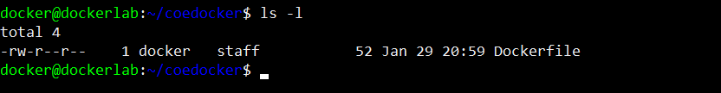

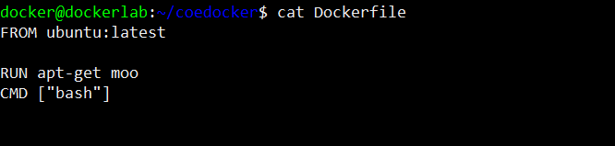
Creating Dockerfile
By creating a dockerfile into our new folder, now we gonna add some directives. The format of dockerfiles is:
Docker runs instructions in a Dockerfile in order. A Dockerfile must begin with a `FROM` instruction.
Common Instructions: ADD COPY ENV EXPOSE FROM LABEL STOPSIGNAL USER VOLUME WORKDIR

Slide 25
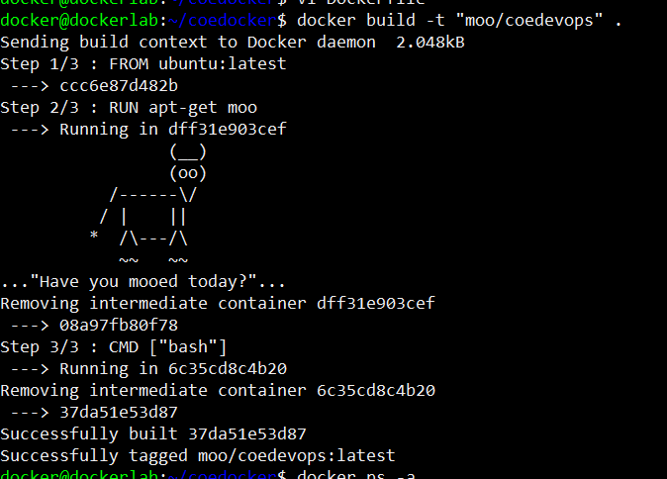
Building Dockerfile
By typing docker build command on our terminal. It receives the dockerfile as argument plus the –t flag which is intended to tag the new custom image.

Slide 26
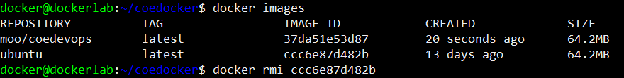
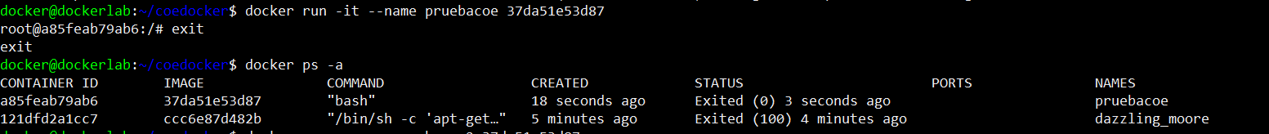
Using the new custom image!
By performing the docker images command on our terminal, we’ll gonna see that the image just built is now available with his own name (moo/coedevops) and his IMAGE ID. Now it’s time to create a new container.

Slide 27
if(questions == FALSE) console.log(“Stay in touch next week!”);

Slide 28
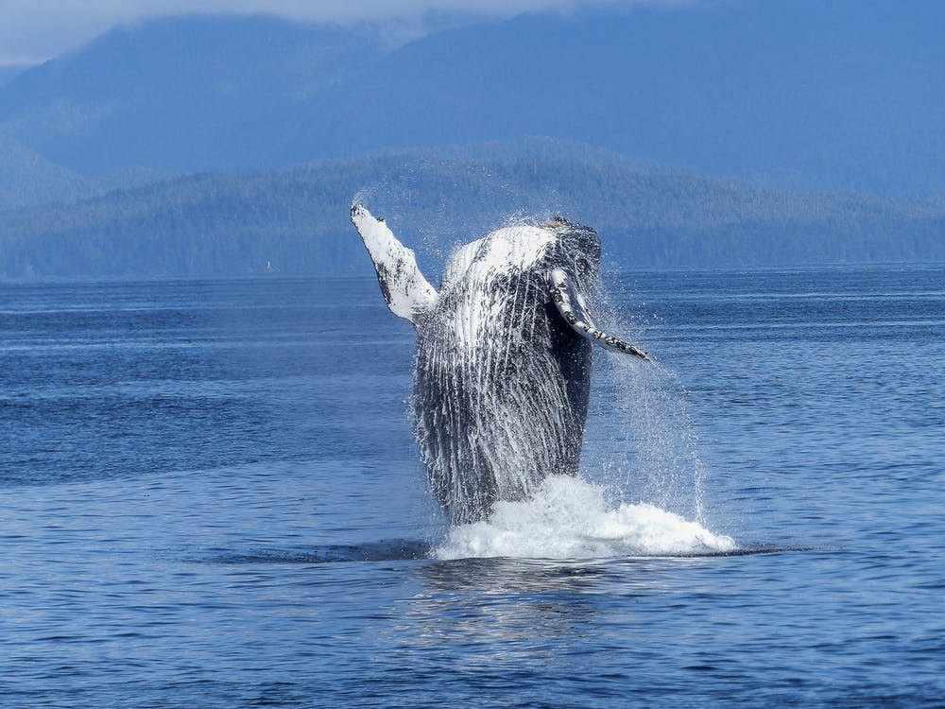
José Castrejón Aguilar
jose.castrejon@softtek.com

